Slide 1
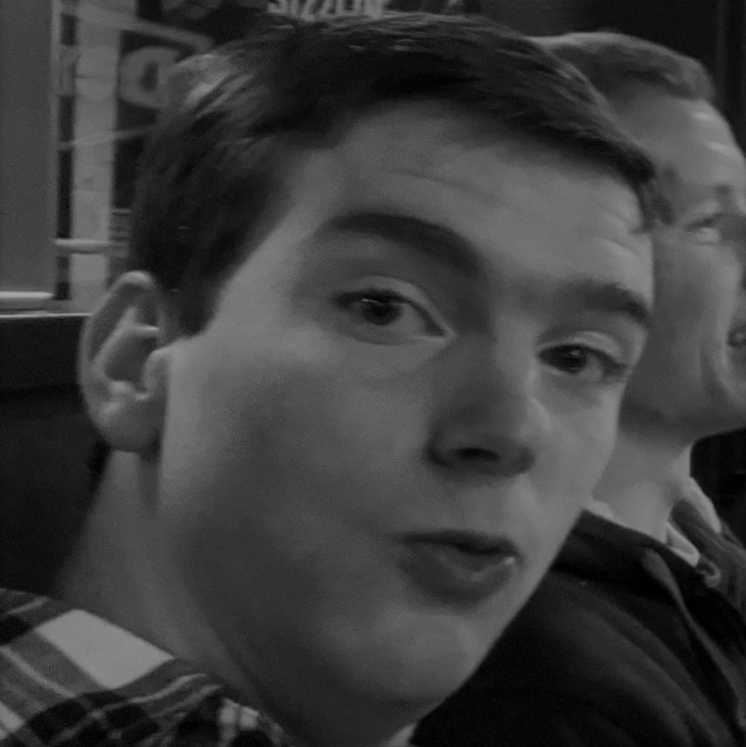

Test Image
Best Match

Slide 2
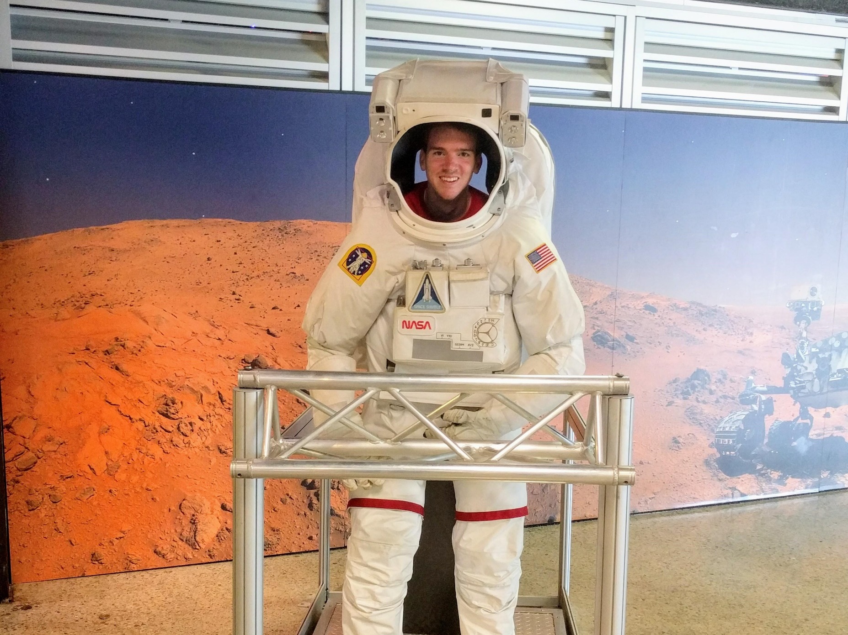
“That’s one small step for man!”

Slide 3

Word2Vec

